Slide 1
Service Above Self
www.rotary.org

Slide 2
…Food for Thought…
“The most powerful force in the promotion of international understanding and peace is exposure to different cultures. The world becomes a smaller, friendlier place when we learn that all people - regardless of nationality - desire the same basic things: a safe, comfortable environment that allows for a rich and satisfying life for our children and ourselves. Youth Exchange provides thousands of young people with the opportunity to meet people from other lands and to experience their cultures. This plants the seeds for a lifetime of understanding.”
~ Rotary International
Notes:
Point out their contact info on handout.
Have them stand up

Slide 3
…Who We Are Internationally...
1.2 million friends, neighbors and community leaders
in
200 countries
in
35,000 Rotary Clubs
organized in
530 Rotary Districts
all comprising

Slide 4
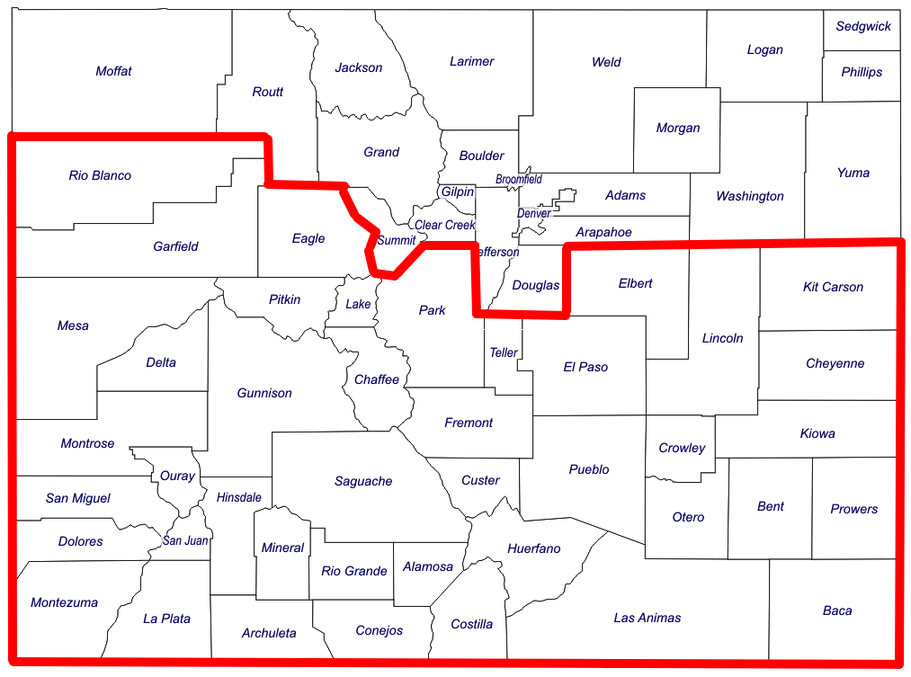
…Who We Are Locally...
District 5470
58 Clubs
2,222 Members

Slide 5
…What Rotary Does…
We come together to create positive, lasting change in our communities and around the world
Our differing countries, cultures, and occupations give us a unique perspective
And most importantly, our passion for service helps us accomplish the remarkable in six areas of humanitarian focus:
Basic education and literacy
Disease prevention and treatment
Economic and community development
Maternal and child health
Peace and conflict prevention/resolution
Water and sanitation

Slide 6
Peace and conflict prevention/resolution

Slide 7
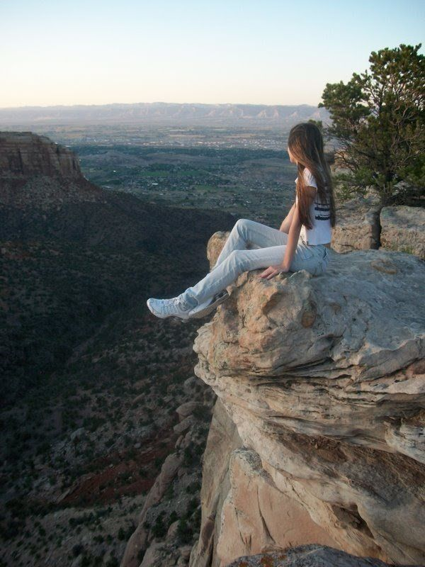
…Rotary Youth Exchange Benefits…
By sharing your own culture and embracing a new one, you help foster global understanding and learn a great deal about yourself and your home country in the process
Provide a broader view of the world and a deeper understanding of yourself
Develop communication and leadership skills
Advances international understanding and global peace!

Slide 8
…How Youth Exchange Operates…
As mandated by the Mutual Educational and Cultural Exchange Act of 1961, the U.S. Department of State’s Bureau of Educational and Cultural Affairs (ECA) works to build friendly, peaceful relations between the people of the United States and the people of other countries through academic, cultural, sports, and professional exchanges, as well as public-private partnerships.
We partner with the WESSEX Rotary Youth Exchange Program (16 Rotary Districts) for U.S. Department of State and Council on Standards for Internation Educational Travel (CSIET) certification.
All of our Rotary Youth Exchange volunteers are vetted through the U.S Department of State, which requires annual background checks, reference checks, and passing of Youth Protection training.
Notes:
The US Department of States uses this as part of their diplomacy efforts. Sanction these efforts to get along with people of the world. Several layers of certification involved.

Slide 9
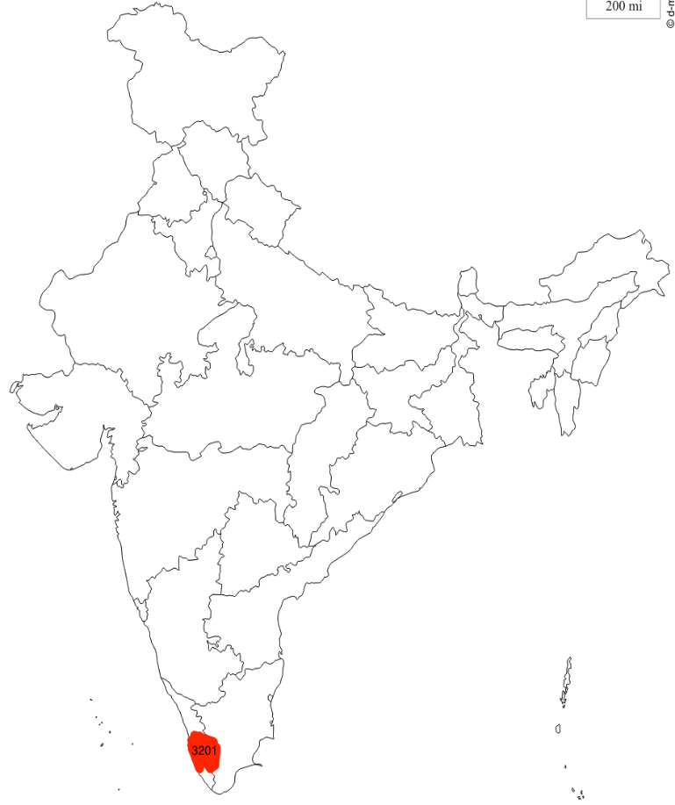
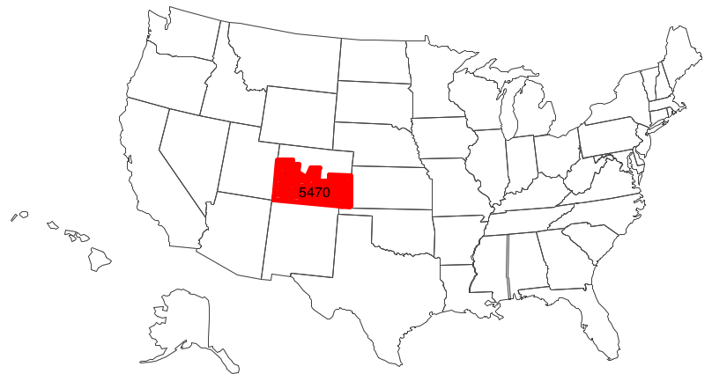
…What Is Rotary Youth Exchange...
A true exchange program: One student from one Rotary District exchanges with one student from another Rotary District:
8,777 exchanges from 456 different Rotary Districts from 80 countries

Slide 10
Every D5470 club can participate!
D5470 in 2016-17: 26 Clubs are participating in RYE by hosting an inbound and/or sponsoring an outbound, for a total of 54 student participants this year.

Slide 11
…Long-Term vs . Short-Term…
Long-Term Exchange
Immerse yourself in a new culture for an entire academic year
Reside with 1-5 host families throughout your exchange (depending on country)
Learn a new language, make lifelong friends
Open to Rotarians and non-Rotarians
Comfortable with very limited communication with family and friends
Short-Term Exchange
Not ready for a long-term exchange commitment? Consider short-term exchange…..
A family-to-family summer exchange program
Typically, the Colorado student will first travel to the international student’s home and spend 3-5 weeks there, followed by the international student coming to the Colorado home for 3-5 weeks
While Rotary facilitates the match, most of the logistics, including travel dates and flight arrangements, are handled by the families
Open to Rotarians and non-Rotarians

Slide 12
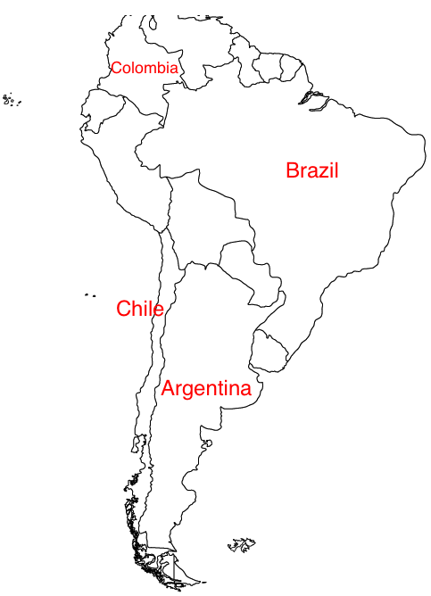
…Countries We Exchange With…
Notes:
Have the opportunity to learn more about this at the country fair/

Slide 13
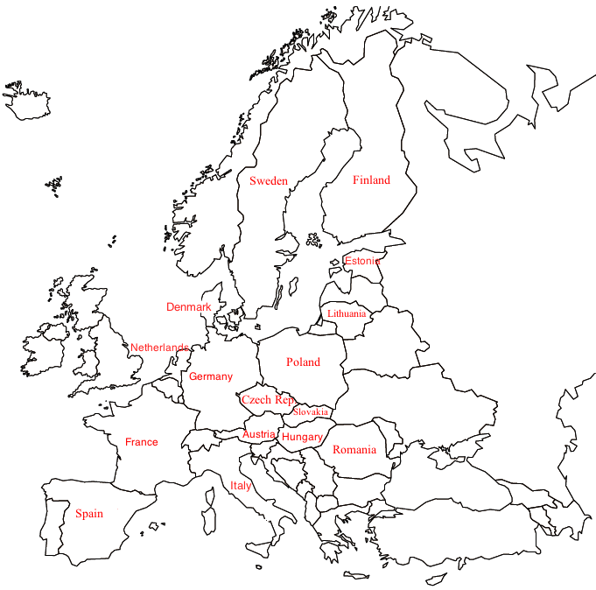
…Countries We Exchange With…
Switzerland

Slide 14
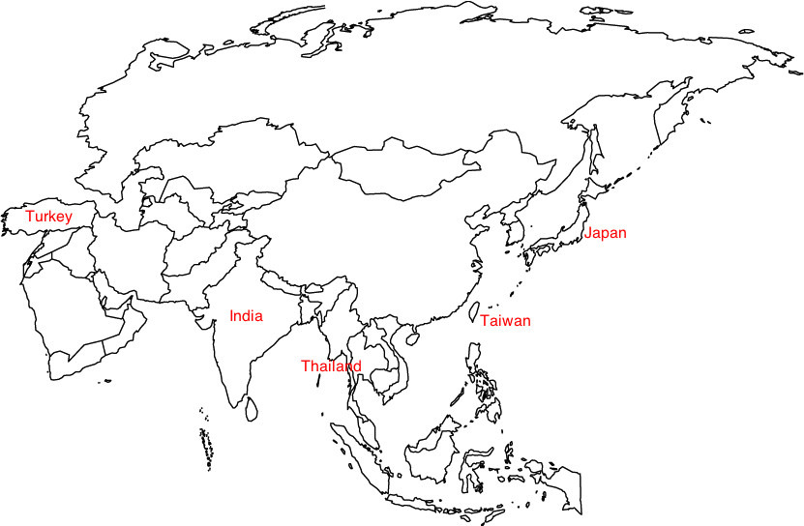
…Countries We Exchange With…

Slide 15
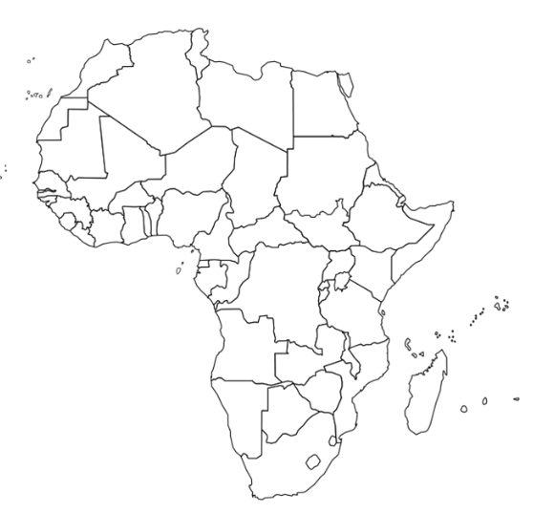
Countries we exchange with…
And our first- ever exchange with Africa this year!
Zimbabwe

Slide 16
Our Club’s RYE Participation

Slide 17
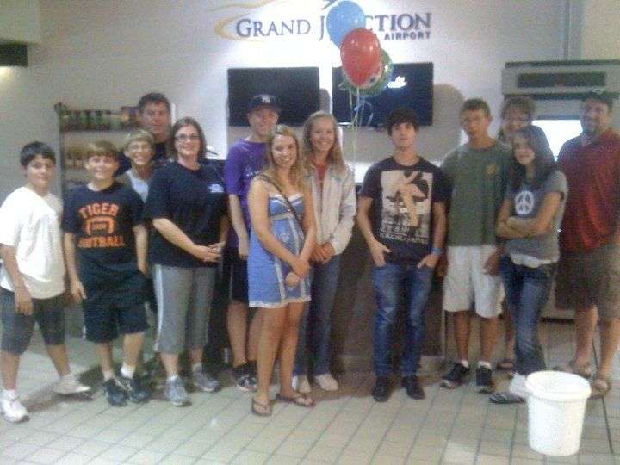
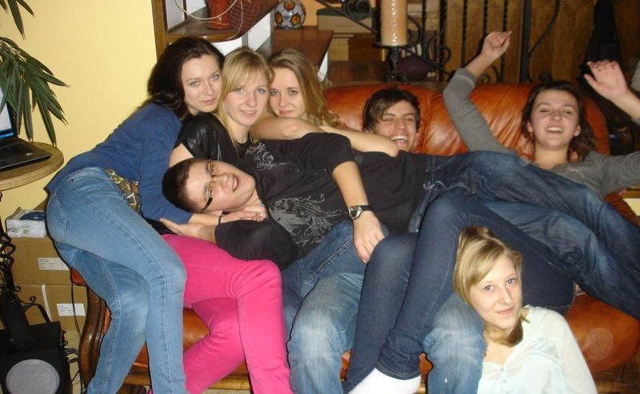
…Inbounds…
From the 24 countries we exchange with
Hosted by Rotary Clubs throughout D5470
Rotary Club is student’s official HOST
Host families are vetted volunteers selected by Rotarians
Try to match host family and high school activities
Help them learn about life in USA

Slide 18
…Want to be involved?...
Host an inbound in your home for 3-4 months
Host an inbound for an afternoon, family dinner, service project
Take an inbound to a sporting event, concert, or ski day
Take an inbound on a weekend family getaway
Promote RYE to local schools, prospective host families, and to students you know
Recruit an outbound candidate

Slide 19
Outbounds - What are we looking for?
Resourceful
Pay attention & follow directions
Self-sufficient
Kind
Flexible
Charming
Helpful
Grateful
Positive attitude
Happy
Willing to try new things
Knowledgeable about the US & your hometown
Ambassador of Colorado, USA, and Rotary
Good student – can you learn a foreign language IN a foreign language?

Slide 20
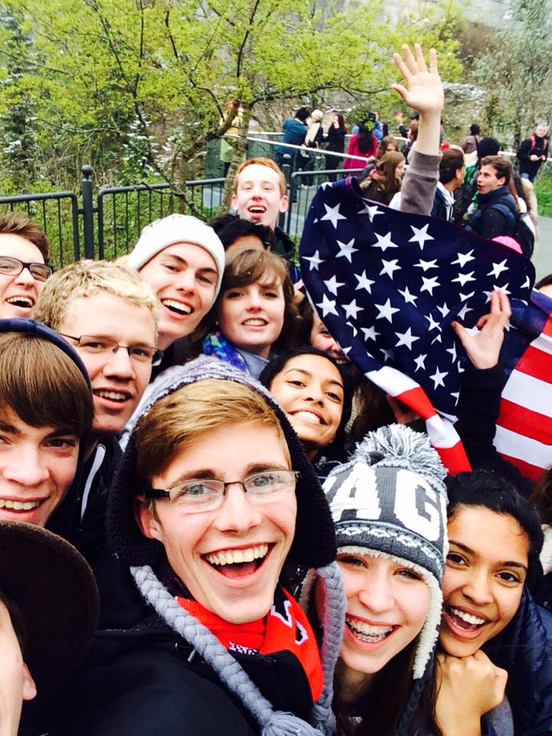
…The Rules…
Rotary Youth Exchange students are subject to rules known as the 4 D’s:
1. No drinking 2. No drugs 3. No driving 4. No dating

Slide 21
Frequently Asked Questions
Program cost $6500, there is a 6-month payment plan, scholarships available with club support
District RYE budget is higher than total district budget. We receive $2-2500 from the district and all other expenses are covered by our Outbounds’ fees
Emergencies – natural disasters, injuries, etc. do happen. The fee includes travel & health insurance.
School credits are solely at the discretion of the student’s high school
Host families – our foreign partners assign 1-5 host families, which varies by Rotary district. We try to assign 3 families in our district to give student a variety of experiences and avoid putting stress on a single family
Language learning is essential! Students should make extra efforts to learn as much as possible prior to departure.
Consulate visits – many countries require a summertime personal appearance to issue a student visa
Travel – students typically have a chance to take an official Rotary tour. Our district partners with other USA district to offer several options in March and June. Students are responsible for tour costs.

Slide 22
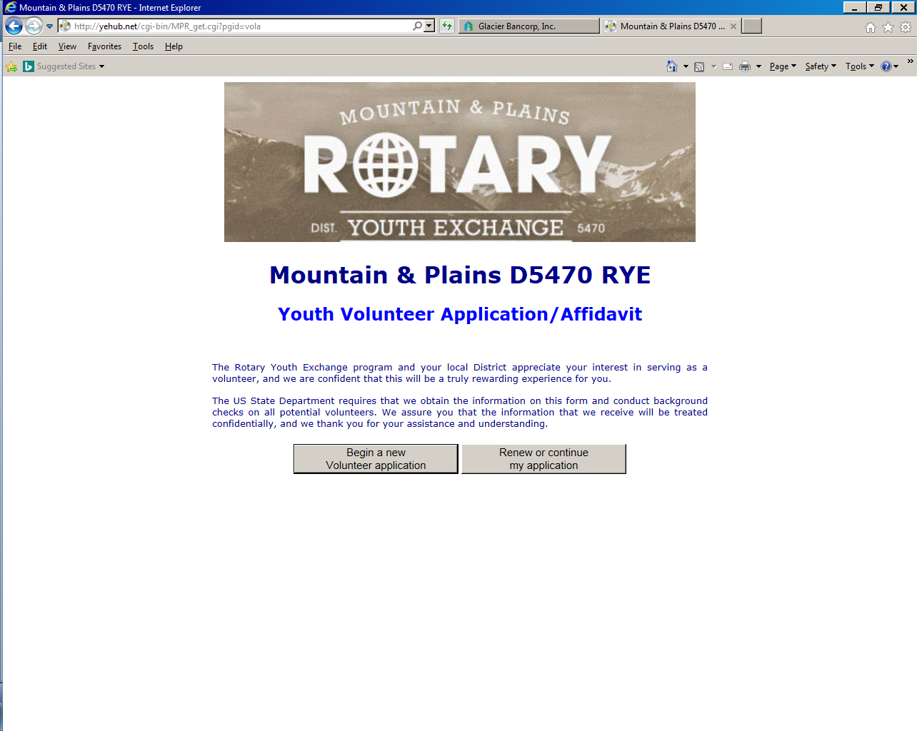
How to become a volunteer…
Volunteer application comes from your Youth Exchange Officer
Complete application with and 3 references
Pass a background check
Take Youth Protection online training module
Serve as Youth Exchange Officer (administrative), Counselor (emotional connection with student) or committee member

Slide 23
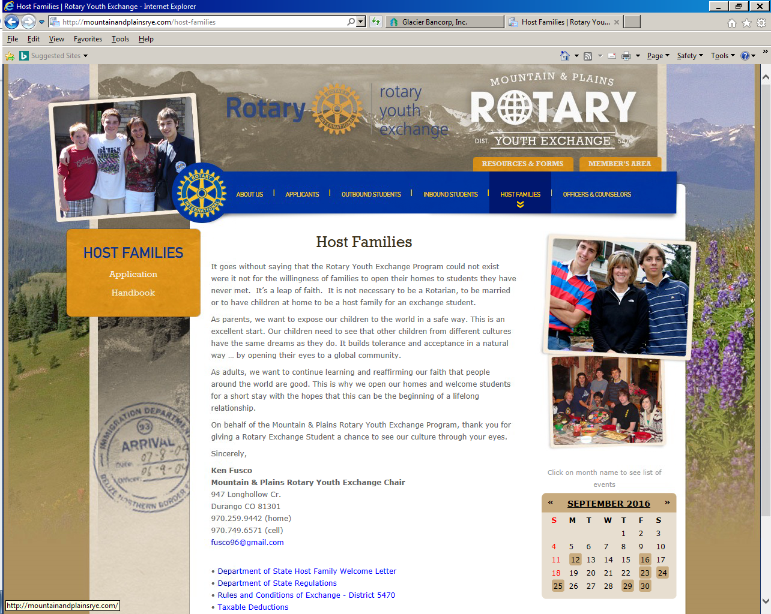
How to become a host family…
www.mountainandplainsrye.com/host-families
Complete application with photos of home and 2 references
Pass a background check
Take Youth Protection online training module
Participate in in-home interview by Rotary Club
Accept the student as a member of your own family for 3-4 months

Slide 24
…D5470 Rotary Youth Exchange…
URL
http://www.mountainandplainsrye.com
Facebook
http://www.facebook.com/mprye

